Slide 1
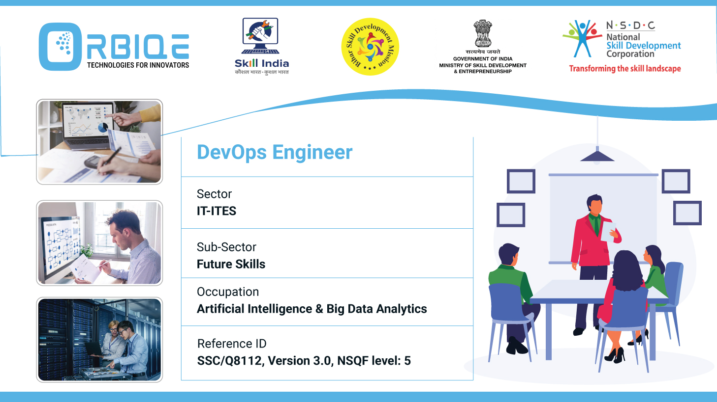
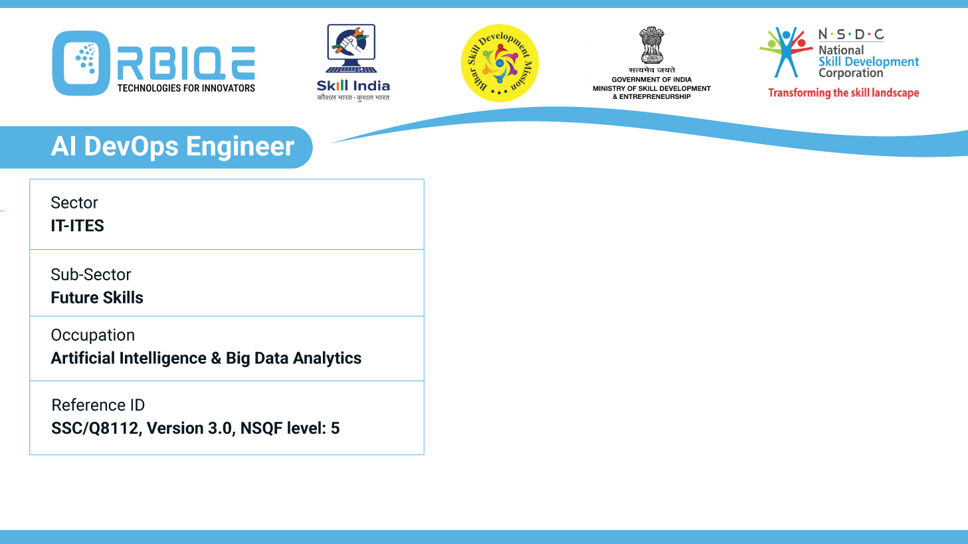
Name- Krishna Kant Dubey

Slide 2

Future Proofing Database Maintenance: Trends and Best Practices

Slide 3
Agenda
Explore emerging trends and best practices in database maintenance, staying ahead of the curve for future-proofing AI Database Administration

Slide 4
key trends and strategies
Autonomous & AI-Augmented Databases
Serverless & Cloud-Native Architectures
Real-Time Analytics & Edge Computing
Vector & Graph Databases
Explainable AI & Agentic Intelligence

Slide 5
Autonomous & AI-Augmented Databases
Self-managing systems like Oracle Autonomous DB and IBM Db2 AI automate patching, tuning, and backups.
AI agents detect anomalies, optimize queries, and even self-heal performance issues.

Slide 6
Serverless & Cloud-Native Architectures
Serverless databases scale automatically and reduce infrastructure overhead.
Multi-cloud and hybrid strategies improve resilience and avoid vendor lock-in

Slide 7
Real-Time Analytics & Edge Computing
Databases optimized for real-time insights are critical for IoT and latency-sensitive apps.
Distributed databases process data closer to the source, improving speed and responsiveness.

Slide 8
Vector & Graph Databases
Ideal for AI workloads like semantic search, recommendation engines, and LLM integration

Slide 9
Explainable AI & Agentic Intelligence
AI systems now offer transparency in decision-making and autonomous root-cause analysis for security and performance

Slide 10
Thank You

